Slide 1


Understanding Aviation Accidents
Insights from 30 Years of Data
A revealing look into trends, risks, and safety in global air travel
Presented by:
Vladyslav Lysenko
Vasudha Chandna
Om Mistry
01

Slide 2

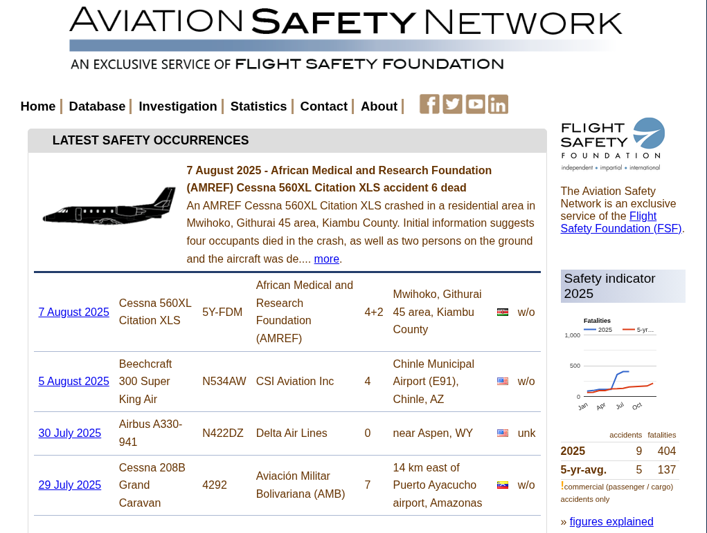

01
8000 accident records
02
Spanning 30 years (1995–2024)
03
Global coverage
04
Focus on high-level accident data
02

Slide 3
Incident
An incident is an occurrence, other than an accident, that affects or could affect the safety of operations
Accident
An accident, is an occurrence where:
A person is fatally or seriously injured.
The aircraft sustains damage or structural failure that adversely affects its strength, performance, or flight characteristics.
The aircraft is missing or inaccessible.
Accordingly to ICAO *
(International Civil Aviation Organization)
03

Slide 4
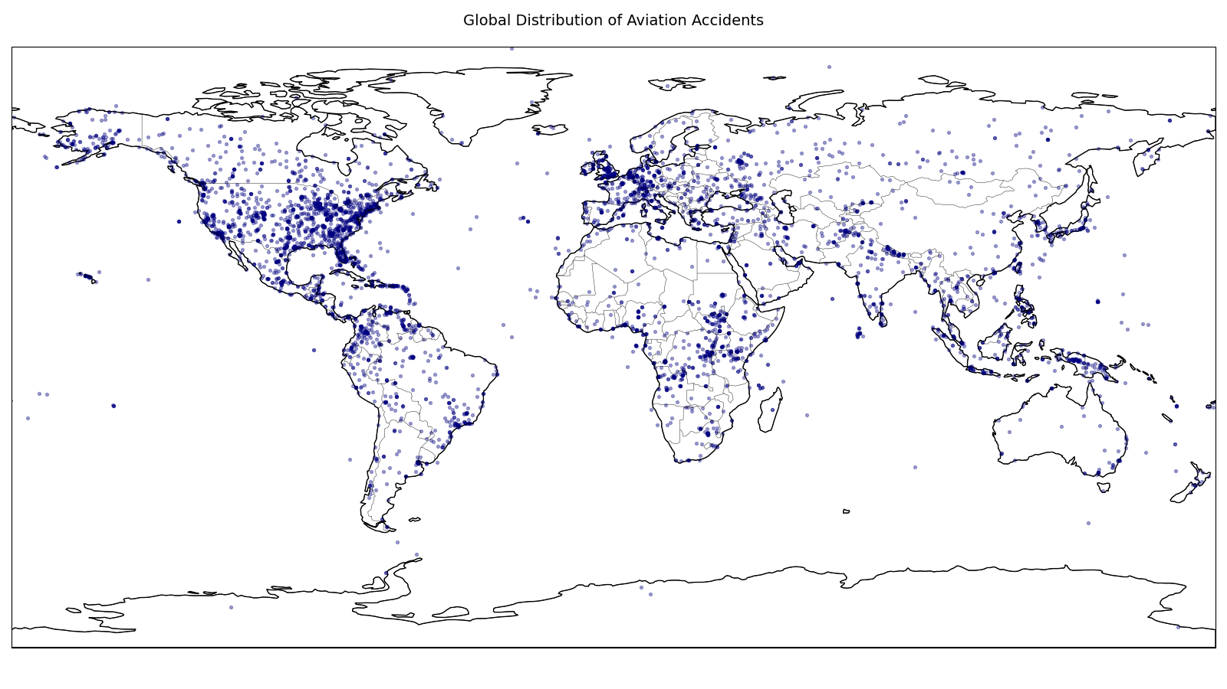
Global Footprint
04

Slide 5
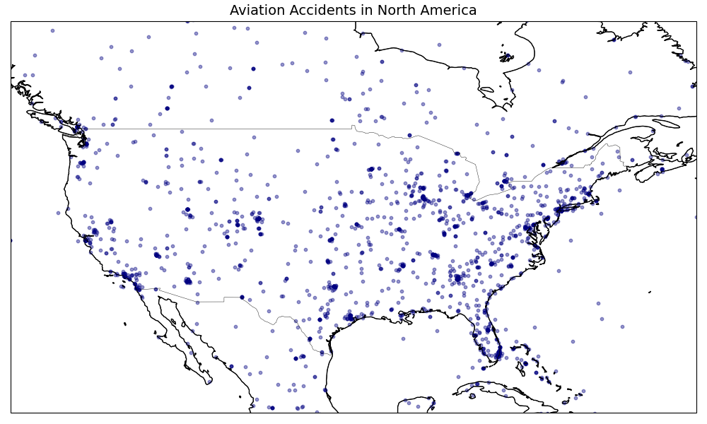
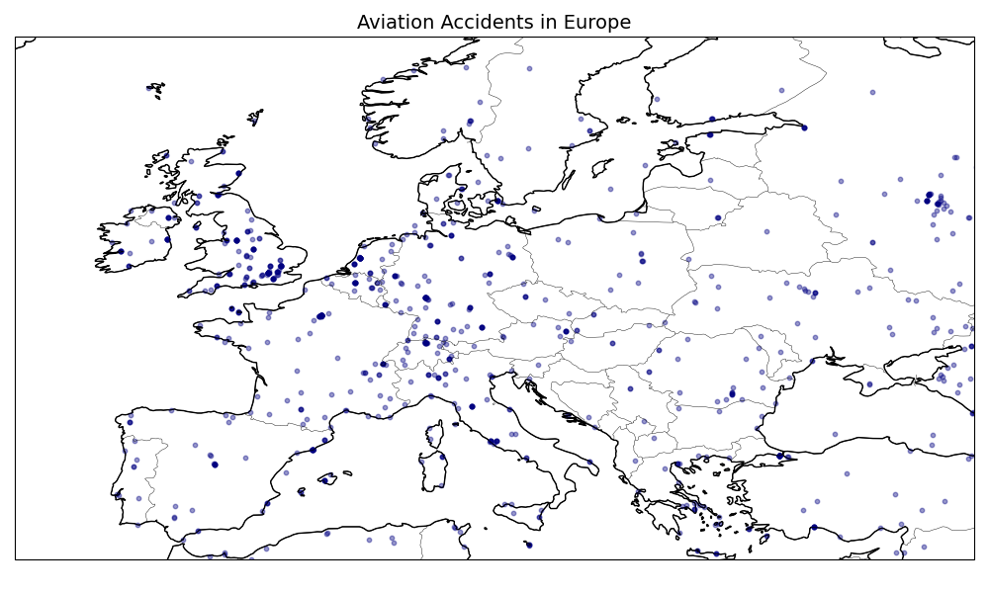
Global Footprint
05

Slide 6
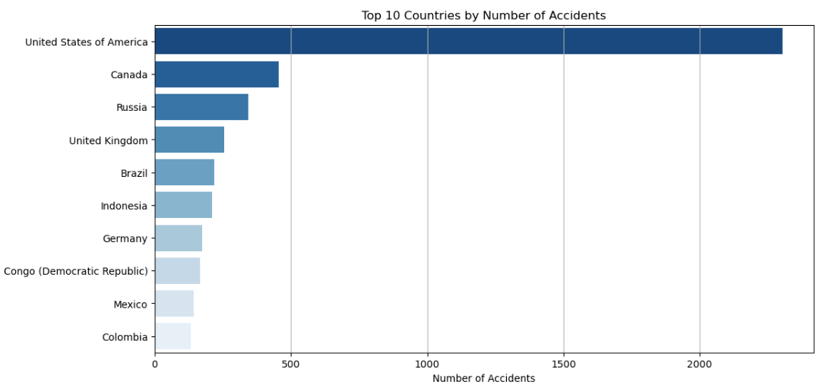
Top Countries by Number of Accidents
06

Slide 7
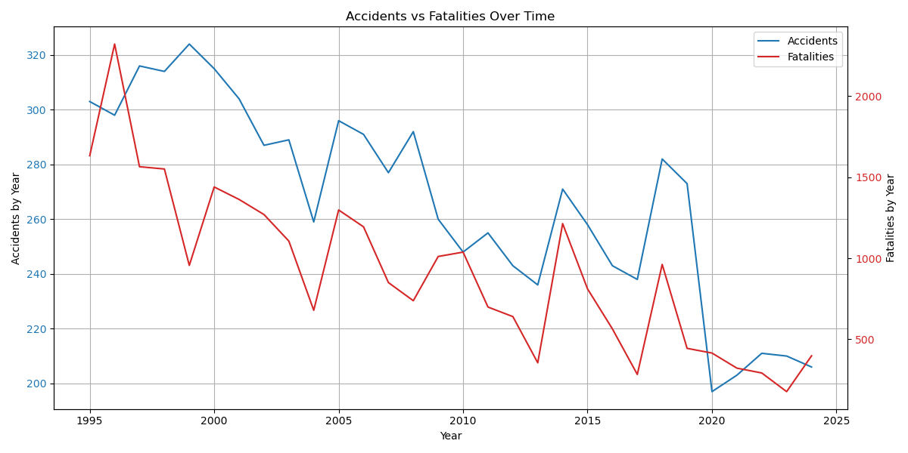
Trends in Aviation Accidents and Fatalities
07

Slide 8
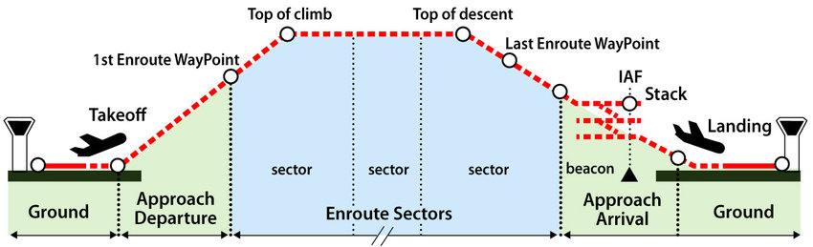
Flight Phases and Accident Risk
08

Slide 9
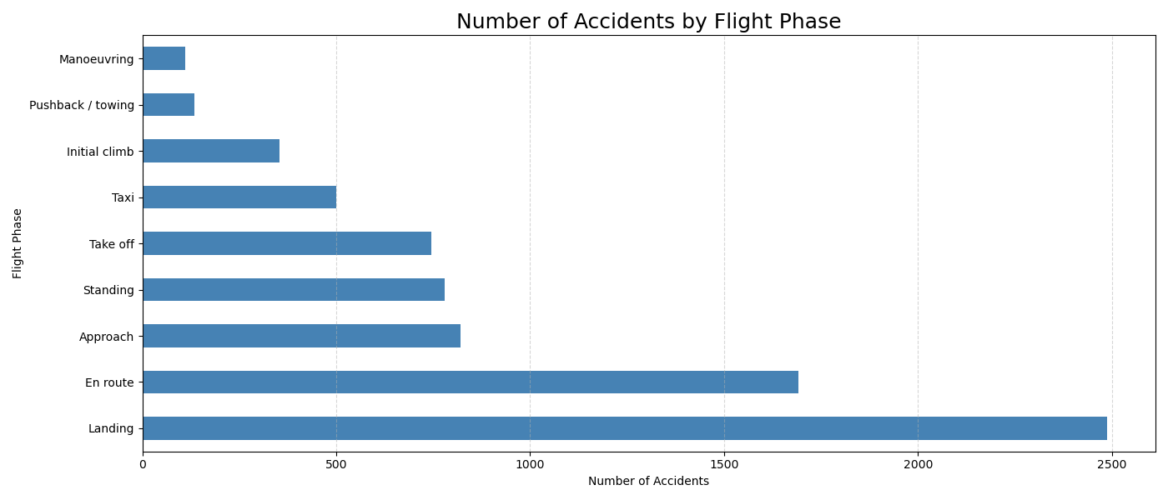
Flight Phases and Accident Risk
09

Slide 10
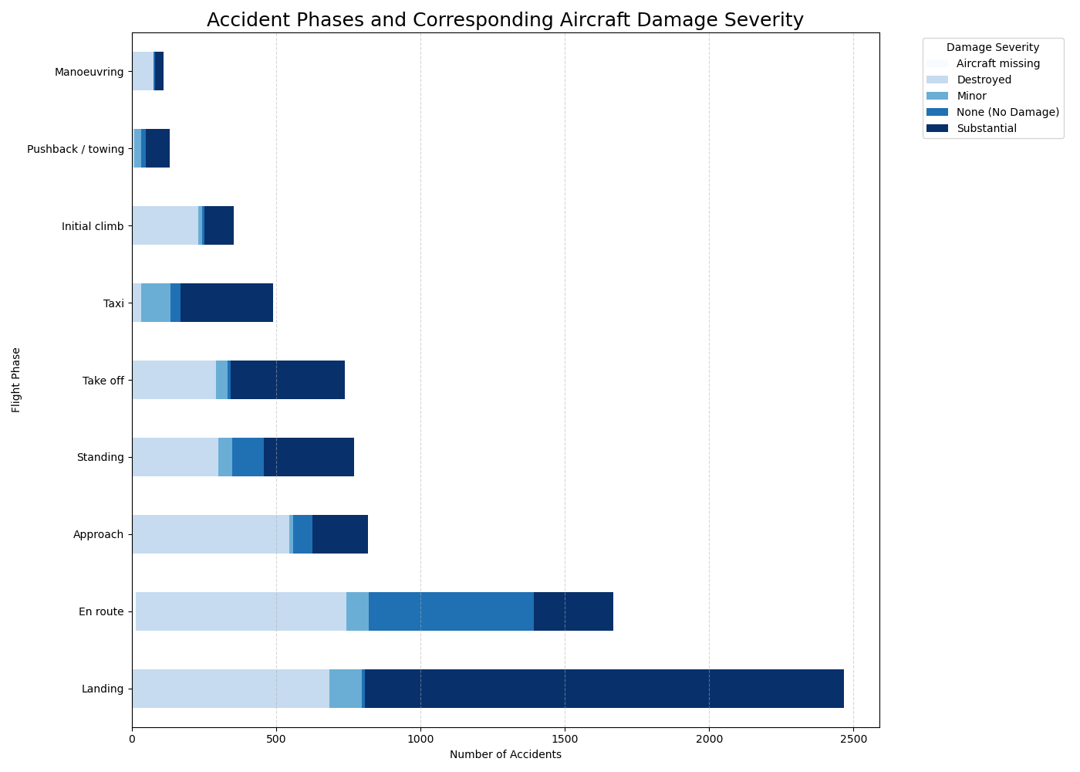
Flight Phases and Accident Risk
10

Slide 11

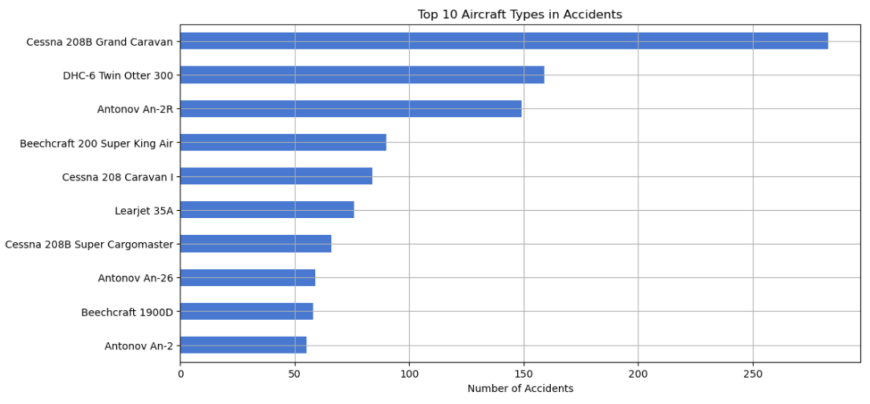
Types of Aircraft in Accidents
11

Slide 12
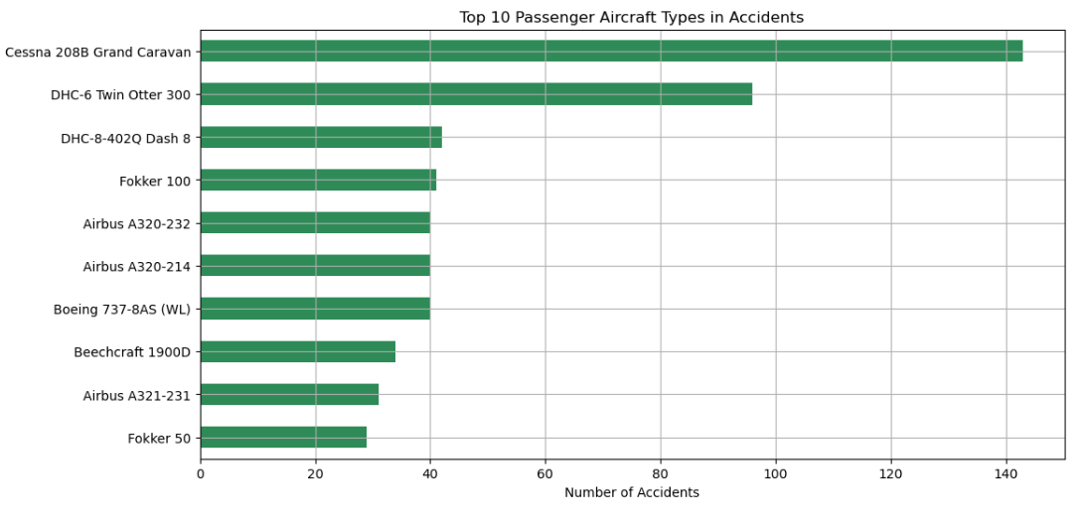
Types of Aircraft in Accidents
12

Slide 13

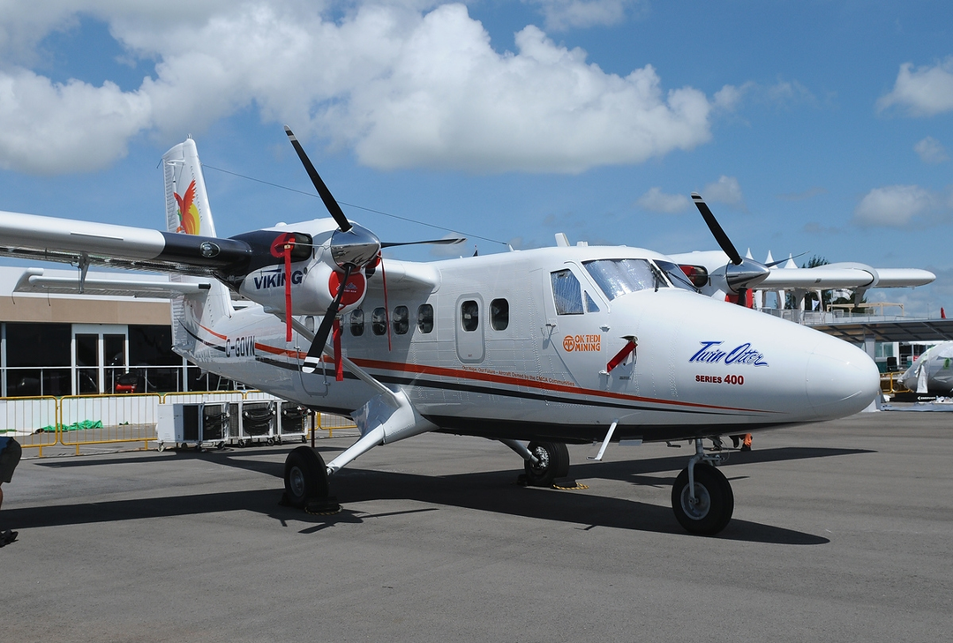

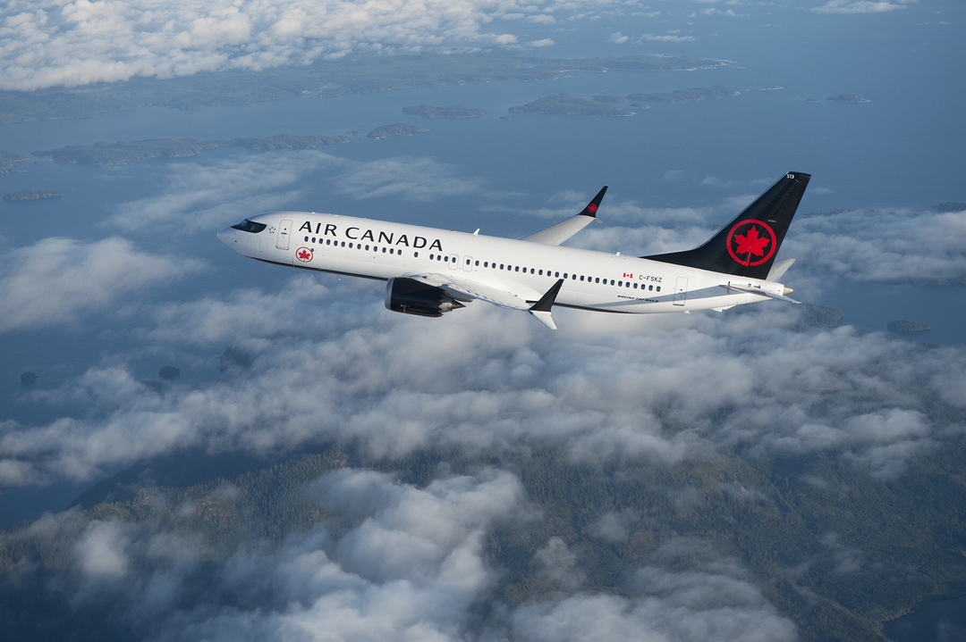
Cessna 208B Grand Caravan
de Havilland Canada DHC-6 Twin Otter
Airbus A320-232
Boeing 737-8AS
13

Slide 14
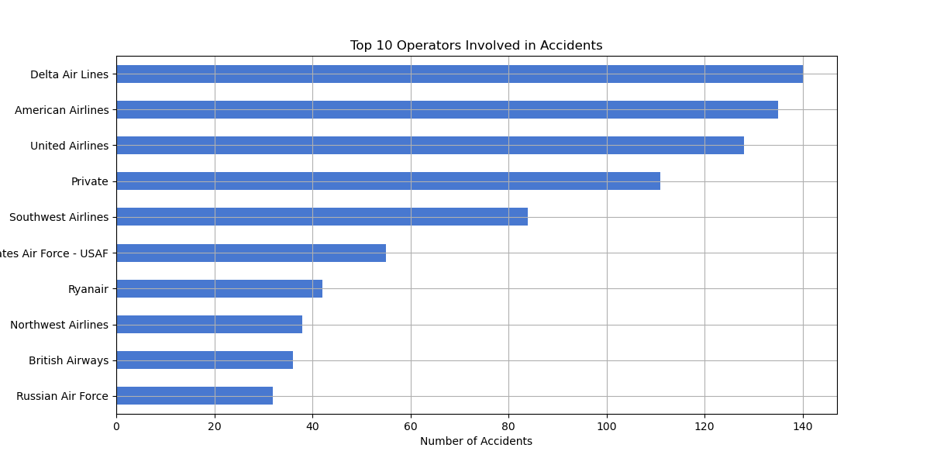
Operators with Most Accidents
14

Slide 15
Thank You For Attention!
Presented by:
Vladyslav Lysenko
Vasudha Chandna
Om Mistry

